Slide 1


Slide 2


It is very important to keep in contact with many People.
But managing all these numbers and information is not so easy!

Slide 3
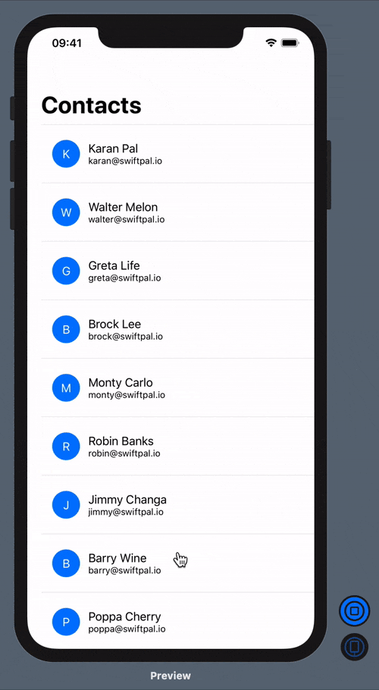
PHONEBOOK

Slide 4



Presented by:
Md. Adnan Abir (202902035)
Nura Anha Tamanna (202902002)
Presented To:
Ohiduzzaman Shuvo
Designation: Lecturer
Green University of Bangladesh

Slide 5

Content
Introduction
Features
Aim of the project
Why linked list
Outcome
Conclusion

Slide 6

Introduction
A Phonebook is an application that lists the names, addresses, and phone numbers of the people and businesses in a certain area.

Slide 7



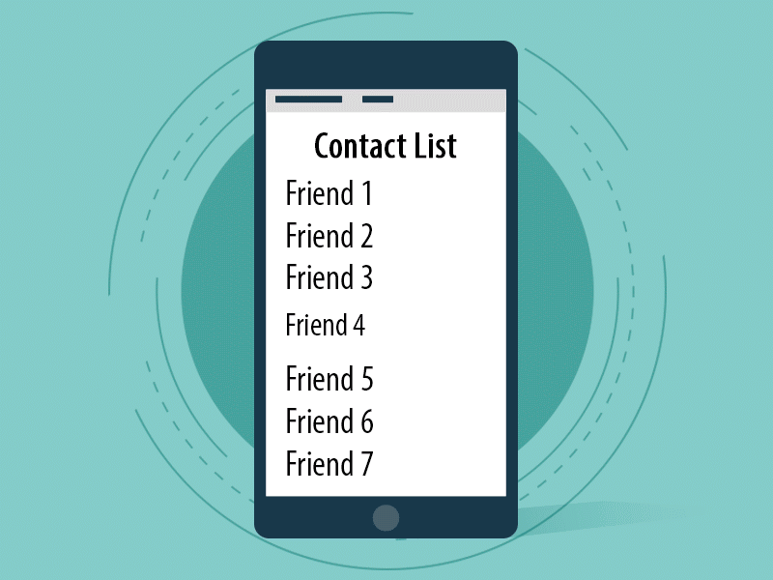
Features
Store complete information
Deletion and modification
Easily find contacts
All contacts in one place.

Slide 8





Aim of the project
helps to understand the basic concepts
will teach beginners
Easy to operate and understand
structured in C language

Slide 9
Dynamic Data Structure
Why linked list
Insertion and Deletion
No Memory Wastage
Implementation
Well organized program
Easy to understand and upgrade

Slide 10
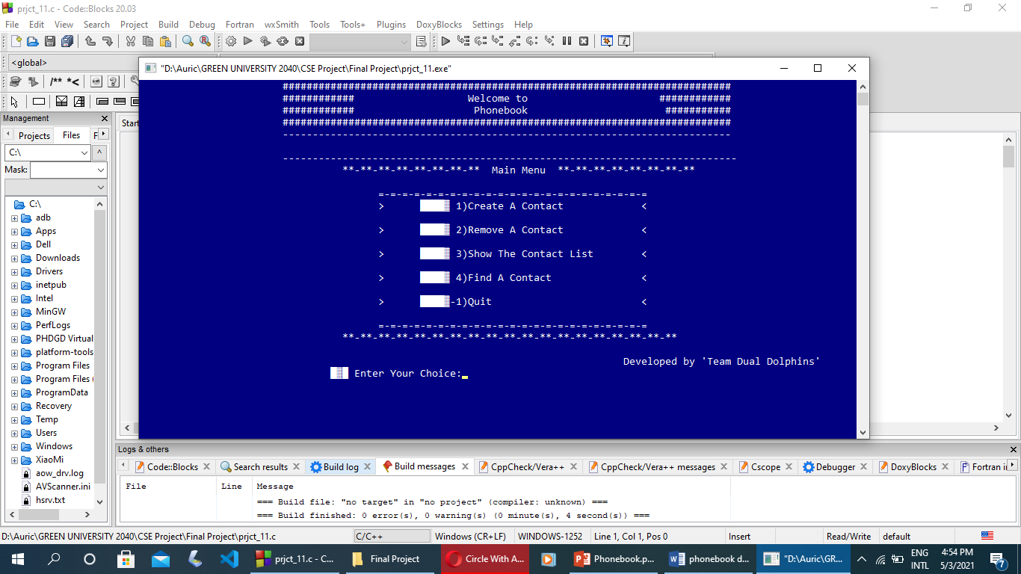
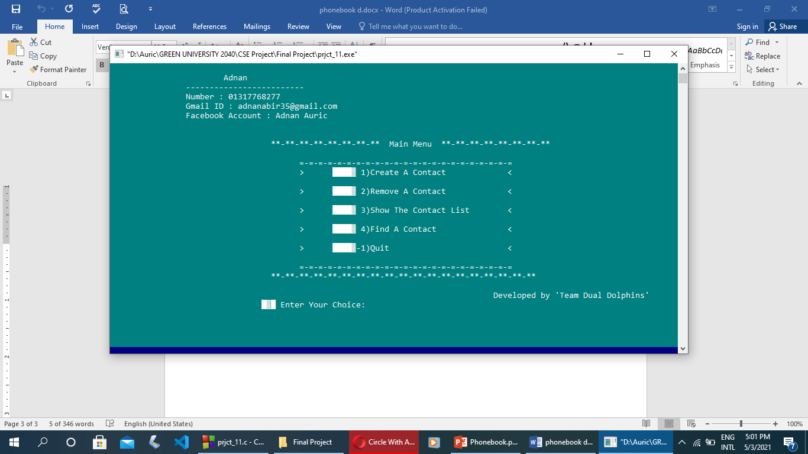
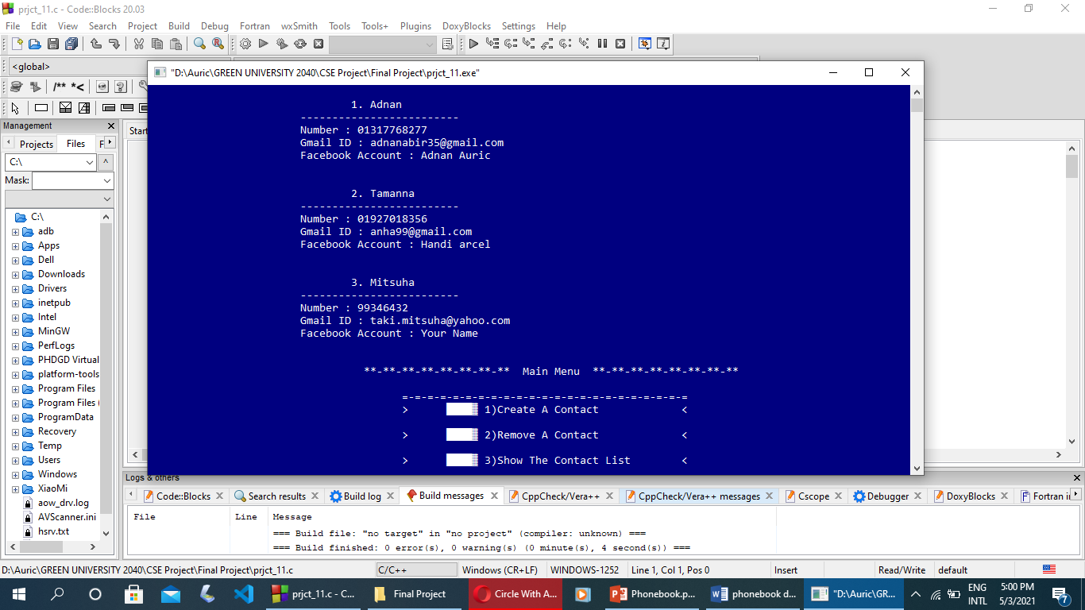

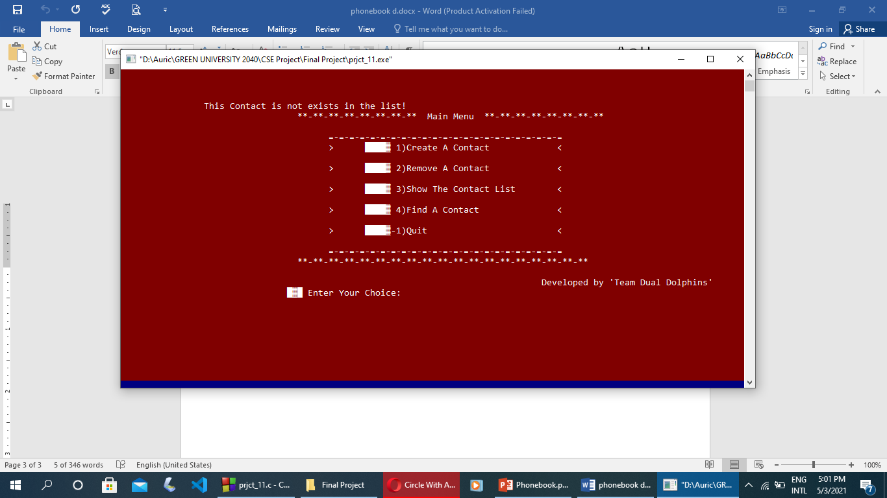
Outcome

Slide 11

Conclusion
Don’t be heisted to inform us, if you found any kind of bugs.
We will try our best to repair that as soon as possible.

Slide 12


